Slide 1
USPS Package Compliance
University Mailing Services
Brought to you by Facilities Management
At Oklahoma State University

Slide 2
The IM®pb or Intelligent Mail Package Barcode
Beginning January, 22, 2017, the United States Postal Services, or USPS, implemented new regulations requiring the USPS Intelligent Mail® Package Barcode (IM®pb), seen here at right, when shipping:
parcels, Flat Rate/Priority Mail
anything weighing more than 13 ounces, or
anything measuring over ¾” thickness, regardless of packaging
any shipment with loose objects (i.e. keys, thumb drives, etc.) regardless of packaging
This only applies to USPS shipments.
Please continue to process your UPS, FedEx, and DHL shipments in the same manner as the 2016 Fall semester.

Slide 3
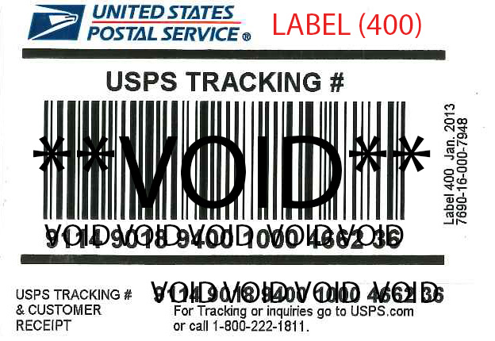
UMS no longer uses the USPS Label (400)
The USPS Label (400), as seen to the right, will no longer be used for shipping through UMS because it does not include the USPS Intelligent Mail® Package Barcode or IM®pb that is now required.
Use of this label will result in a $0.20 penalty as well as a higher shipping rate.
Any parcels required to have an IM®pb label, will be shipped with one created by our staff to keep us within our volume range for lower shipping rates, with the penalty and shipping cost difference assessed to the shipper’s account number to pay for labor and you will not receive a tracking number. The only way to receive a tracking number through the USPS is by creating a ship ticket with Endicia.

Slide 4
Endicia.com Provides a Solution:
Endicia is the electronic software solution that makes shipping with the United States Postal Service easier, cheaper, faster, and more efficient while complying with new USPS Intelligent Mail® Package Barcode (IM®pb) shipping requirements. Having an IM®pb provides less expensive shipping rates, is faster (as it streamlines shipping with the USPS), provides a tracking number, and e-mail notifications regarding your shipment.
UMS has secured all OSU departments access to the Endicia Ship Ticket portal for shipping with USPS, through the following website: http://endicia.com/shipticket.

Slide 5
Signing up in order to use the Endicia
To sign up with Endicia Ship Ticket, visit http://endicia.com/shipticket and select the "Sign Up" link located in the upper right-hand corner of the page. You do not have to create an account to use Endicia if you use more than one account number. The best way to do that is using the Shipping Request beside the sign up link.

Slide 6
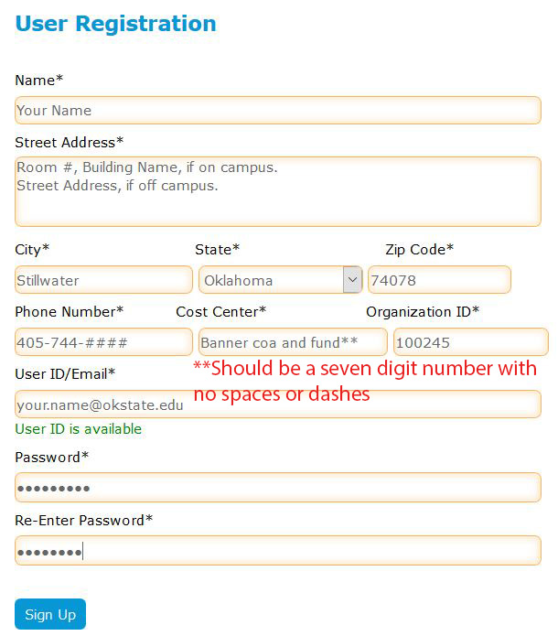
Once you have clicked on the "Sign Up" link, you will be asked to provide information in order to create a shipping profile with information such as your name, your address (room # and building name, if on campus), your phone number, Cost Center (banner coa and fund number, with no dashes or spaces, or bursar number), your organizational ID (always 100245), an e-mail address to receive tracking numbers and notifications.
E-mails will be sent when your shipment leaves UMS, when it is accepted at the Downtown US Post Office, and when it is delivered to the recipient. Note: In order to receive email notifications, you will also need to enter your e-mail address as the recipient's e-mail address each time you ship.
You will be able to edit your shipping profile, in case of a change in information or in order to use different banner funds for different shipments. When finished, click on the Sign Up button at the bottom of the page.

Slide 7
Creating Ship Tickets With Endicia
The next screen will allow you to begin creating ship tickets, first asking you which service request option that you would like (either 2-3 days or overnight). Overnight is faster but more expensive. Options are also available for insurance, insurance amount, and signature confirmation requests.

Slide 8
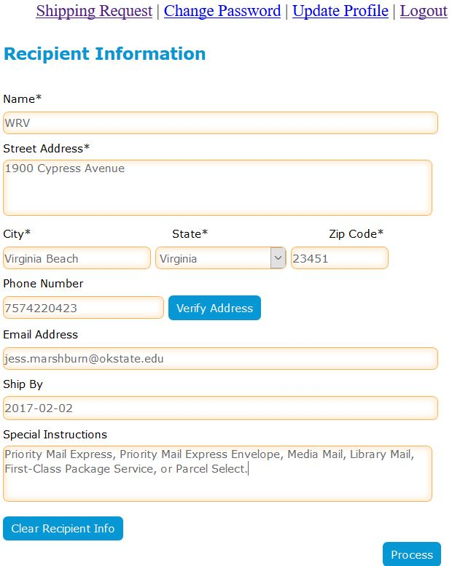
On the same page, you will be able to enter the recipient's information, including the recipient's name, street address, city, state, zip code, phone number, an e-mail address, ship date, and special instructions for shipping options.
If you would like to receive any e-mail notifications, including tracking number, ship date, acceptance to the downtown Stillwater US Post Office, and when it is delivered, you will need to reenter your e-mail address in the recipient's e-mail address field.
Available shipping options include Priority Mail Express, Priority Mail Express Envelope, Media Mail, Library Mail, First-Class Package Service, and Parcel Select.

Slide 9
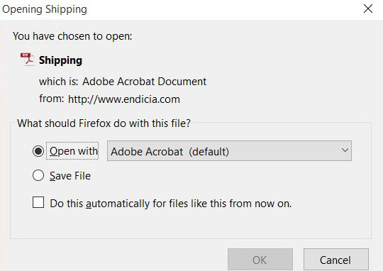
To finish your ship ticket, click on the "Process" button. An "Opening Shipping" dialogue box will appear asking how you would like to proceed.
For best results, select the "Open with Adobe Acrobat (default)" option.

Slide 10
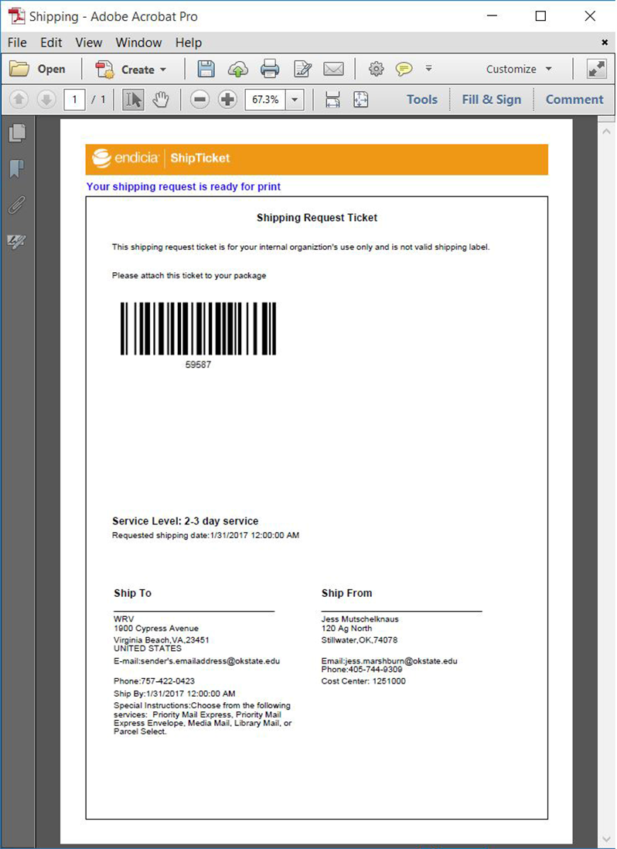
From there, you will be able to view, save, and print your ship ticket on plain white paper.
The ship ticket’s barcode holds all of the sender’s and receiver’s information, as well as the shipping options chosen for the shipment.
It is recommended that you save a copy of this ship ticket as a PDF for your records. UMS will need you to keep your Ship Ticket’s information, in case you need additional information and for your financial records.

Slide 11
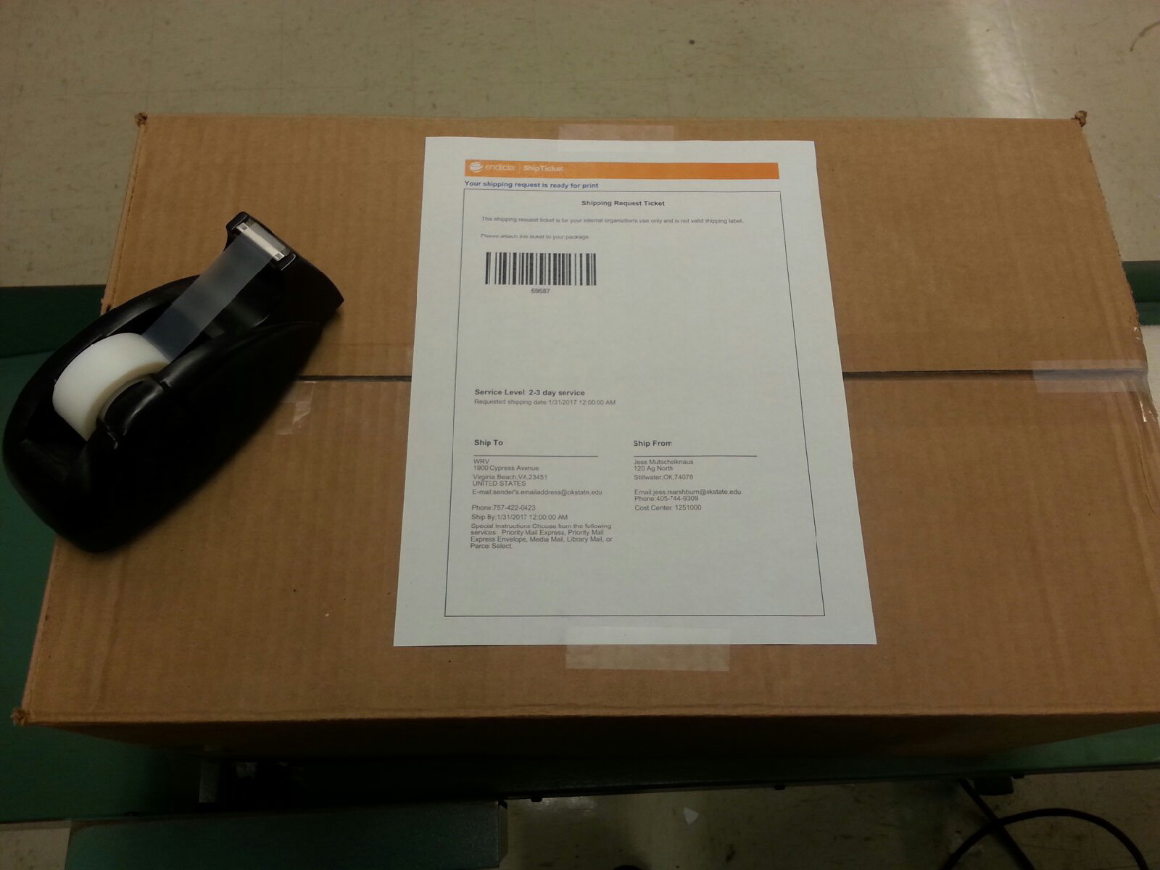
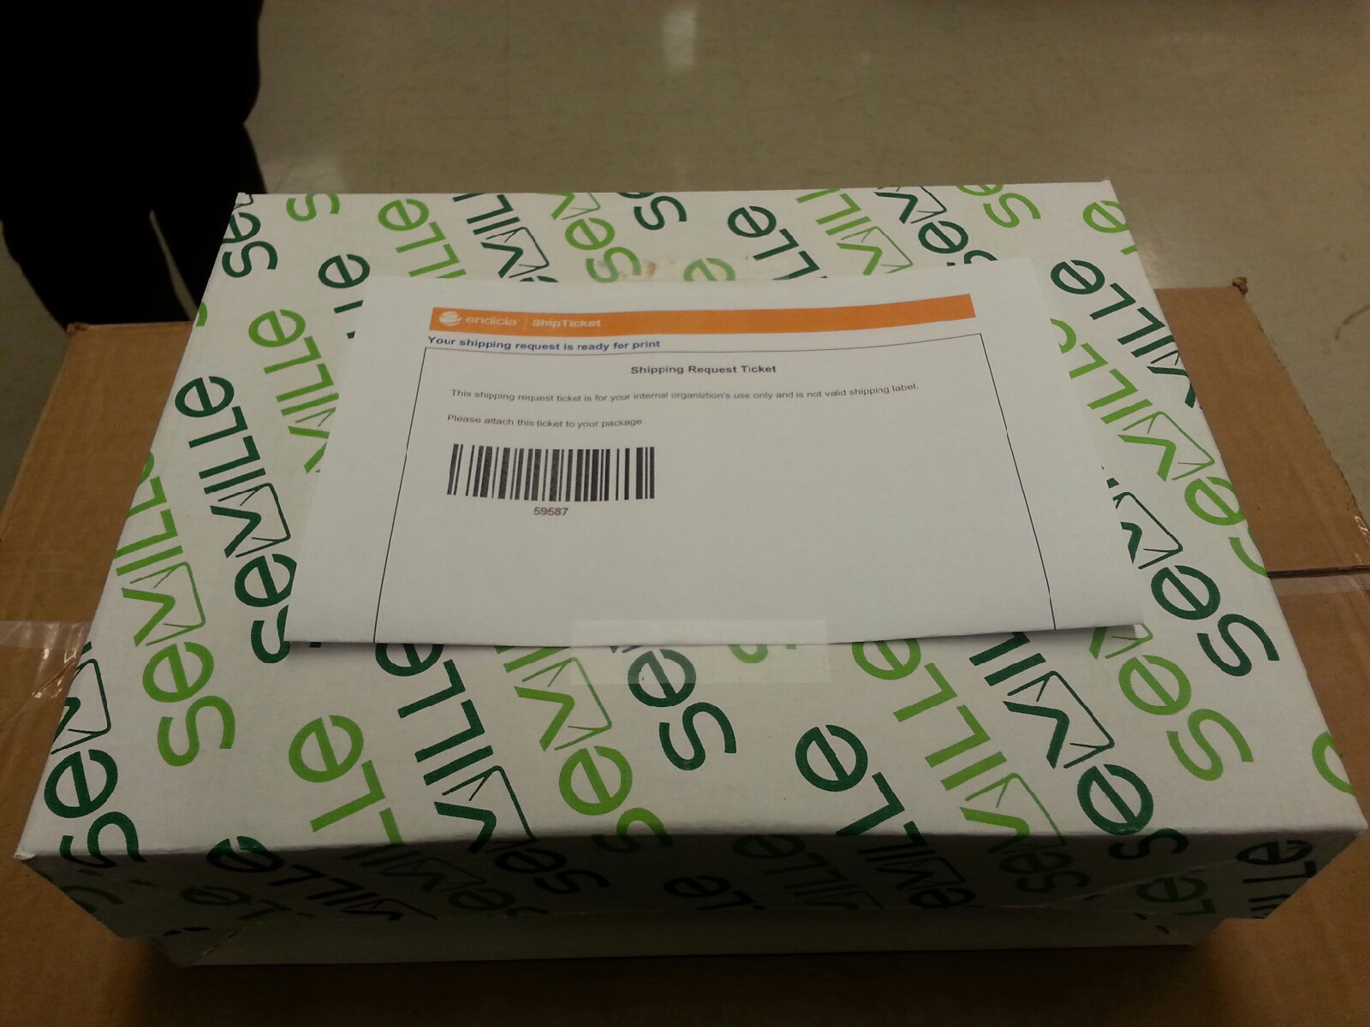
After printing, affix the shipping ticket with the barcode facing up to your shipment with two small pieces of tape (please do not tape all of the edges down) and put into your outgoing mail so that UMS may pick it up.
If the shipment is smaller, you may fold the ship ticket in half and affix to the piece, as long as the barcode is still showing.

Slide 12
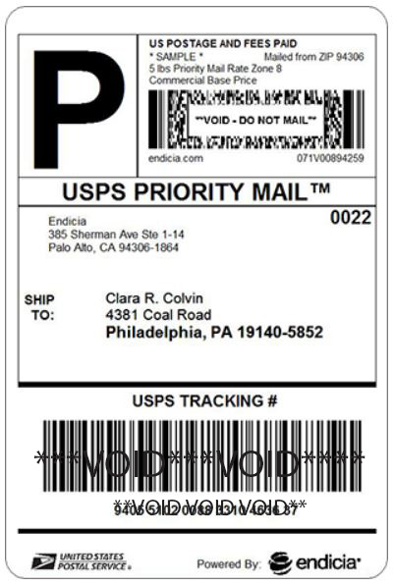
After UMS picks up your package, we will scan the ship ticket, weigh the piece, and print a label with the new Intelligent Mail® Package Barcode (IM®pb).
At this time, an e-mail containing the generated tracking number and ship date will be sent to the e-mail address provided in the recipient's e-mail address field entered when creating the ship ticket. Additionally, when the downtown Stillwater US Post Office accepts the shipment and when the shipment is delivered to the recipient, you will receive e-mail notifications reporting these events.
You may then track the package through the USPS website, http://www.usps.com/. Sender information, including contact information and funds, may be edited for future shipments, to provide flexibility when ordering or when sender contact information needs to be updated.

Slide 13
Frequently Asked Questions:
When should you use endicia.com to make a ship ticket?
When shipping with USPS anything:
over 13 ounces
over ¾” in thickness
that is a loose object regardless of packaging, weight, or thickness
shipped Flat Rate, Priority Mail, or boxes
for which you would like a tracking number provided
that you would have used the USPS Label (400) to ship

Slide 14
What should I remember when signing up?
To fill out all areas completely, such as name, address, city, state, zip, Cost Center, and organizational ID
Your address should be your room number and building name if on campus
Your Cost Center is your Banner COA and fund number with no spaces or dashes (ex. 1251000, seven digits all together) or your bursar number with no spaces or dashes (ex. 12345678, eight digits all together)
Your organizational ID will always be 100245
You may edit these pieces of information as you need to in order to use different banner funds or bursar numbers by clicking on the Update Profile link after signing in to endicia.com/shipticket (located above the Recipient Information fields)

Slide 15
What should I remember when creating shipping labels?
Enter your email address into the recipient’s email address field to receive the tracking number and delivery notifications
You do not have to enter a phone number for the recipient or click on the verify address button on the Recipient’s Information field
Creating shipping tickets allows you to save the ship ticket PDF for your records. Shippers are expected to maintain their records for financial and operational reasons. Having these records will make requests to UMS for additional information possible. UMS will not be shipping tracking information through campus mail to departments after the grace period is over. However, through Endicia’s Ship Tickets program, tracking information will be e-mailed to the e-mail address provided in the Recipient’s Information during creating the ship ticket

Slide 16
How long of a grace period am I going to have before I need to sign up for Endicia Ship Tickets/comply with USPS regulations?
Until March 1, 2017
But you may start before then if you would like
After March 1, 2017, items sent to UMS to be shipped through the USPS that are required to have Ship Tickets will be processed through Endicia’s Ship Ticket program by UMS and the shipper’s fund will be charged the $0.20 penalty and the difference of the shipping rates (for labor), and no tracking number will be able to be provided to the Department.
Even if your department is not complying, UMS will comply in order to keep shipping rates lower for the University. Volume plays a part in qualifying for lower shipping rates.

Slide 18
Thank you for your participation in this program as we endeavor to make shipping easier, faster, cheaper, compliant, and more efficient.
Updates are available at http://ums.okstate.edu
Please call 405-744-5385 or send an e-mail to UMS at UMS@okstate.edu for additional assistance and support.

