Slide 1
Handle mail with care
Use the arrow keys to navigate
Or the Page Up and Page Down keys

Slide 2
Recent real-world events require that we view our surroundings in a new and different light. Terrorist attacks increased public awareness of safety procedures that can protect us.
Be assured that the United States Postal Service and OSU Mailing Services do everything reasonably possible to insure your safety. We screen all incoming mail to protect you. If we find anything that is suspicious we will stop it in our postal operation.
We are taking your safety very seriously!

Slide 3
However, no screening is 100% effective.
That’s why we developed this program to help you recognize a potentially harmful mail piece and instruct you what to do if you get suspicious mail.

Slide 4
General guidelines
Do not eat or drink while handling the mail.
If you have open cuts or skin lesions on your hands, wear disposable vinyl gloves.
Upon completion of your postal task wash your hands with anti-bacterial soap and warm water.

Slide 5
Main threats
Bomb Anthrax

Slide 6
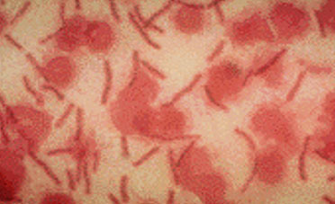
What is anthrax?
Anthrax is a bacterial disease caused by Bacillus Anthracis.
Anthrax occurs in domesticated and wild animals.
Anthrax is an invisible bacteria that can live in soil, water, and dead animals.
Picture of anthrax spores

Slide 7
Three forms of Anthrax
Skin or cetaceous form may be contracted by exposure to spores. It first appears as a rash or blister that may resemble a bite, progressing to a painless ulcer with a black area in the center. It can be treated effectively with antibiotics. Represents 95% of cases of human anthrax.
Inhalational form may be contracted by breathing in spores or dispensing within a closed space. It first appears as flu like symptoms.
Gastrointestinal tract form may be contracted by ingesting improperly cooked, contaminated meat.

Slide 8
The risk of contracting any disease from the outside of any envelope is extremely low.
However, treatment with antibiotics begins immediately after exposure:
Penicillin
Doxycycline
Ciproflaxin (Cipro)

Slide 9
What mail is suspicious?
Anything out of pattern!
If you have received a piece of mail which looks different from what you receive usually, be cautious.
Remember, OSU Mailing Services usually delivers mail at the same time and leaves it at the same spot every day. If you find a piece of mail in a different place, it could be left by somebody else.

Slide 10
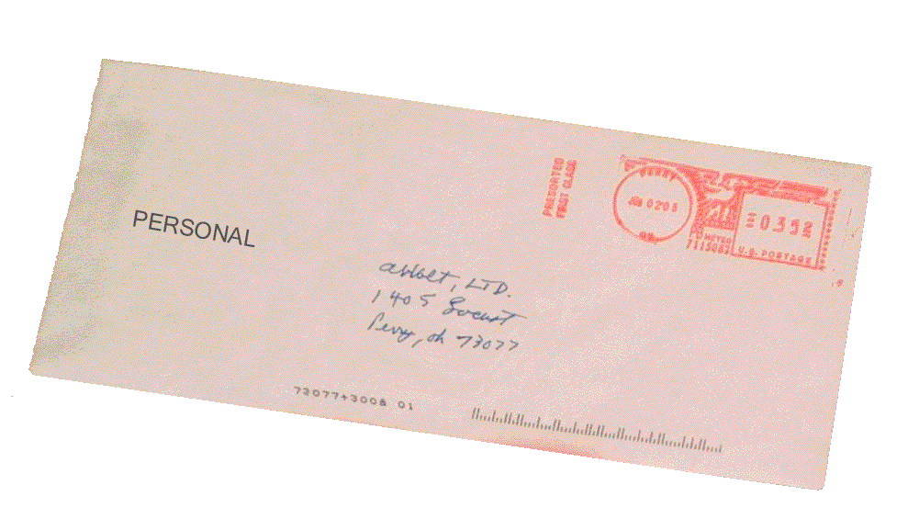
What mail is suspicious?
Look for a combination of the following signs:
No return address
Restrictive markings
Misspelled words
Badly typed or written

Slide 11
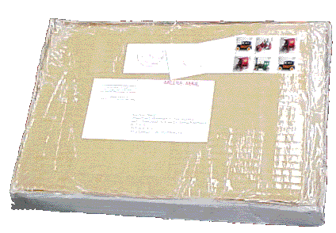
What mail is suspicious?
Look for a combination of the following signs:
Excessive postage
Possibly mailed from foreign country
Lopsided
Rigid or bulky

Slide 12
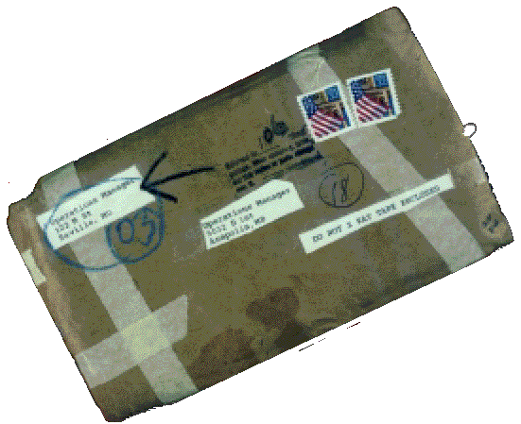
What mail is suspicious?
Look for a combination of the following signs:
Oily stains, discolorations, or crystallization on wrapper
Protruding wires
Excessive tape or string
Rattling or other sounds
Strange odor

Slide 13
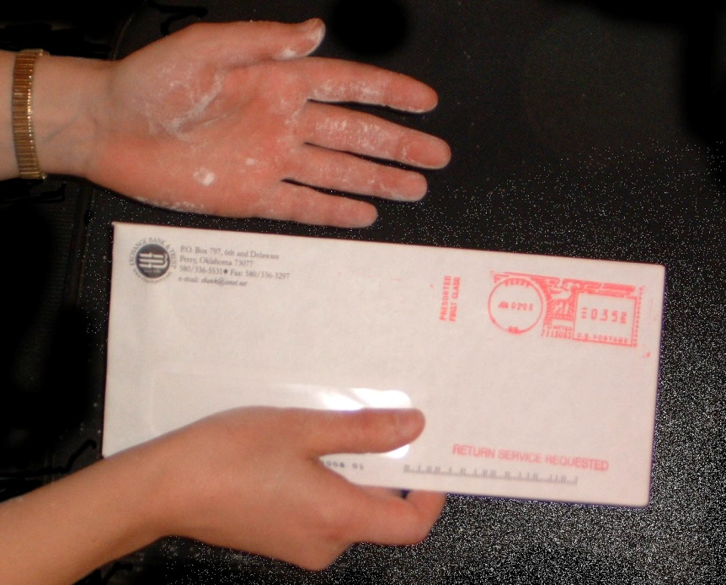
What mail is suspicious?
Uneven, spongy appearance
Powder on surface
Powder on hands
Powder flies when handled

Slide 14
If you receive a suspicious letter or package What should you do?
DO NOT OPEN
Do not move
Do not shake or bump

Slide 15
If you receive a suspicious letter or package What should you do?
Place it in a plastic bag or cover the envelope, letter, and contents.

Slide 16
If you receive a suspicious letter or package What should you do?
Notify your immediate supervisor and OSU Campus Security

Slide 17
If you receive a suspicious letter or package What should you do?
Turn A/C off.
Leave the room and close the door.

Slide 18
If you receive a suspicious letter or package What should you do?
WASH your hands with in a weak bleach solution or with soap and water.
Ensure that all persons who have touched the letter wash their hands.
If possible, take a shower.

Slide 19
If you receive a suspicious letter or package What should you do?
List all people who were in the room when this suspicious letter or package was recognized.
Keep this group together until Security arrives.

Slide 20
If you receive a suspicious letter or package What should you do?
Follow all instructions from the OSU Emergency Response Team
End

