Slide 1
General Awareness Training
Completion of this training satisfies the federal requirements for general awareness training.
All University Mailing Employees work with or around dangerous goods everyday.
It is essential for all UMS employees to understand the markings and labels on the packages entering and leaving the OSU campus.

Slide 2
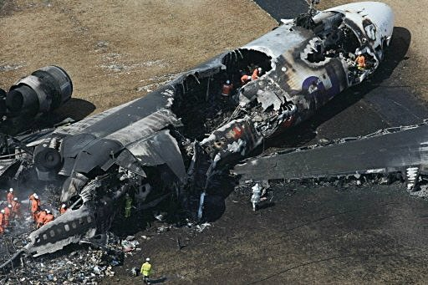
General Awareness Training
Something as simple as a box with undeclared dry ice can cause an aircraft to crash.

Slide 3
General Awareness Training
Failure to follow federal regulations regarding hazardous materials can result in fines of more than $15,000 and jail time per mistake per box.
Ship four boxes with four mistakes on each and you could face $240,000 in fines plus jail.

Slide 4
General Awareness Training
There are nine hazard classes as defined by the Code of Federal Regulations (CFR) section 49 and parts 100-185.
Safety is the primary concern of the Hazmat regulations
Hazardous Materials and Dangerous Goods are interchangeable terms.
The United States uses the term Hazardous Materials
Most other parts of the world use Dangerous Goods

Slide 5
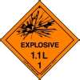
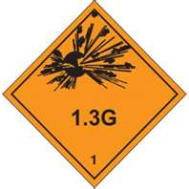
Hazard Classes
Class 1 – Explosives
Division 1.1 Articles and Hazards having a mass explosion. (Ammonium Nitrate)
Division 1.2 Articles and substances having a projection hazard but not a mass explosion hazard. (Tear-gas cartridges)
Division 1.3 Articles and substances having a fire hazard, a minor blast hazard and/or a minor projections hazard but not a mass explosion hazard (Ammunition, practice)

Slide 6
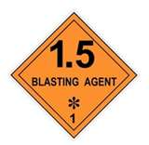
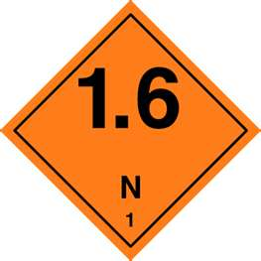
Hazard Classes
Class 1 – Explosives (continued)
Division 1.4 Articles and substances presenting no significant hazard, explosion limited to package (Roman candles, toy caps)
Division 1.5 Very insensitive substances having a mass explosion hazard (type E blasting agents)
Division 1.6 Extremely insensitive articles which do not have a mass explosion hazard

Slide 7
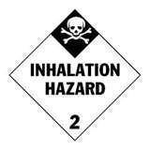
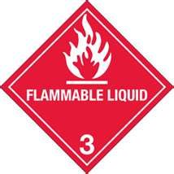
Hazard Classes
Class 2 – Gas
Division 2.1 Flammable Gas (butane lighters)
Division 2.2 Non-flammable, non-toxic gas – under pressure, inert, etc. (Cryogenic liquid)
Division 2.3 Toxic Gas (Hydrogen chloride)
Class 3 – Flammable Liquids
Gasoline

Slide 8
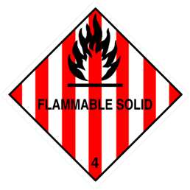
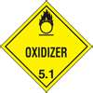
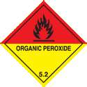
Hazard Classes
Class 4 – Other Flammable Substances
Division 4.1 Flammable Solid (Vegetable
Fibers, Dry)
Division 4.2 Substances liable to spontaneous combustion (Hafnium powder, dry)
Division 4.3 Dangerous when wet (Lithium)
Class 5 – Oxidizing Substances and Organic Peroxides
Division 5.1 Oxidizers (Nitrates, inorganic)
Divison 5.2 Organic peroxides

Slide 9
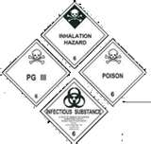
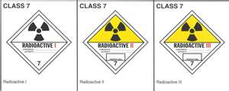
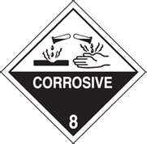
Hazard Classes
Class 6 – Toxic and Infectious Substances
Division 6.1 Toxic Substances (Some pesticides)
Division 6.2 Infectious substances (Regulated medical wastes)
Class 7 – Radioactive Material
Class 8 – Corrosives (Battery fluid, acid)
Class 9 – Miscellaneous Dangerous Goods
Dry ice
Asbestos

Slide 10
General Awareness Traning
If a hazmat package arrives damaged, the package should be refused and a member of the Dangerous Goods Unit should be notified immediately.
The Dangerous Goods Unit is comprised of three people.
Donna Morris
Barbara Dobson
Seth Becker

Slide 11
General Awareness Training
If you discover a suspicious or leaking package, do not move the package and notify a member of the Dangerous Goods Unit.
Along with the required Hazard Class labels, orientation labels are a good indication that a package could be hazardous.
Beware of boxes that arrive cold. Even if not marked they could contain dry ice or infectious substances

Slide 12
General Awareness Training
The Dangerous Goods Unit must approve any radioactive or infectious substance shipments leaving the OSU campus.
We search for suspicious packages not only to meet 49CFR requirements, but to also document hazardous shipments.

