Slide 1
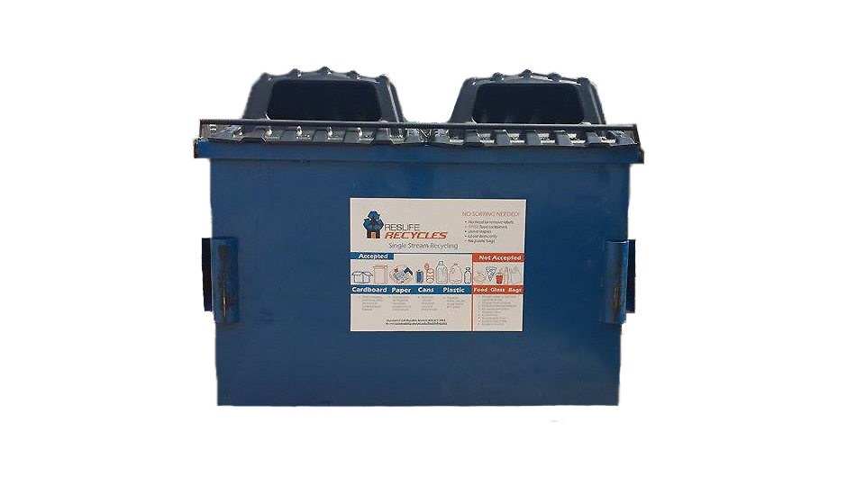
Sustainability.okstate.edu/rlr
@OSUgreen #OSURLR

Slide 2
Reslife recycles program Mixed Recycling
What cannot go in:
What can go in:
Paper: White or colored, junk mail, magazines, newspapers, journals, telephone books, paper bags, manila folders (staples okay)
Cardboard: Breakdown before placing in dumpster!
Plastic: Bottles, jars, tubs marked #1-5; rinsed (labels/lids/caps okay)
Aluminum Cans: rinsed
Metal/Tin Cans: rinsed; labels okay
NO: plastic bags or film; glass of any kind; soiled paper; paper towels; tissues; wax-coated paper; #6 & #7 plastic; food or liquid; disposable plates, cups, bowls; batteries; textiles; or trash!
We are counting on you to be recycling leaders!

Slide 3
Who takes out my recyclables? It’s up to you!
You are responsible for taking your recyclables outside and placing them into a blue ResLife Recycles dumpster
No plastic bags can go into the blue dumpsters; if you collect recyclables in a plastic bag, empty the contents into the blue dumpster and reuse your plastic bag, toss it into a beige trash dumpster, or recycle it where you make purchases
Paper bags are accepted in blue dumpsters so they make ideal totes for your recyclable materials

Slide 4
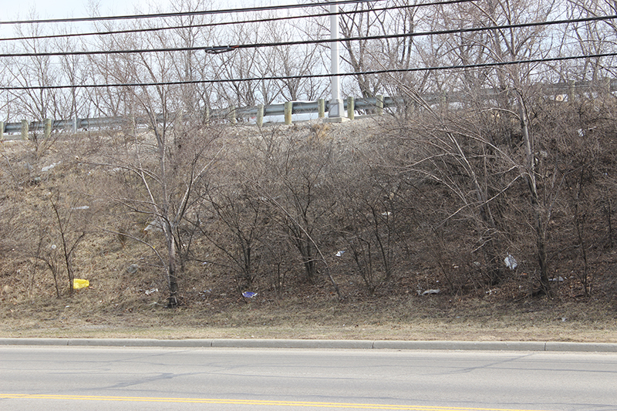
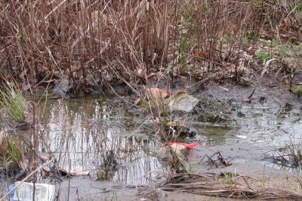
Take the extra step!
Trash Blows into Environment
Trash Trucks Cannot Access Dumpster
Keeps Campus Clean
Keeps Rodents Away
Sustainability = Good Stewardship

Slide 5
Helpful Resources sustainability.okstate.edu/rlr

Slide 6
Questions? Concerns?
Certain blue recycle dumpster locations have specific challenges because trash and recycle dumpsters could not be placed side-by-side (Bennett, NOMO, P-J, Kerr).
GCA custodial staff are people too – don’t take your personal trash or recyclables to common area trash or recycle bins, such as those in lounges. You know what we’re talking about!
Get to know your Eco-Rep or become one for your hall by contacting the RHA University Relations Director, Ryan Northcutt.
Remember to refer to sustainability.okstate.edu/rlr for a wealth of information about your new ResLife Recycles program.

